Slide 1




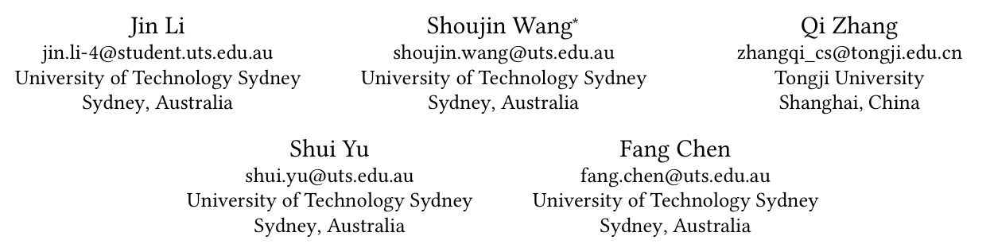



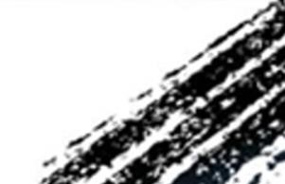

ATAI
Advanced Technique of Artificial Intelligence
ATAI
ChongqingUniversity _{AdvancedTechniqueof}
of Technology Artificial Intelligence
Chongqing University of
Technology
Chongqing University ^{ATAI}
_{of Technology} Advanced Techniqueof
Artificial Intelligence
Chongqing University of Technology
Chongqing University of Technology
Generating with Fairness: A Modality-Diffused Counterfactual
Framework for Incomplete Multimodal Recommendations
Code: https://github.com/JinLi-i/MoDiCF
——WWW_2025
Reported by Yuhang Jang
1

Slide 2
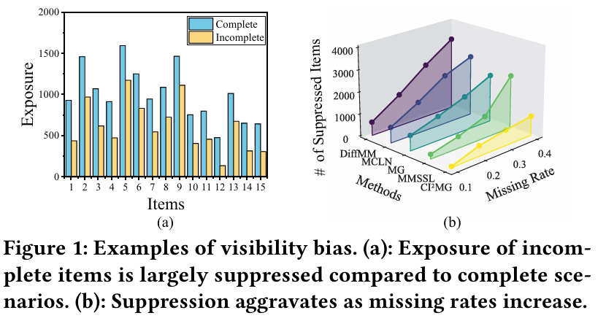
ATAI
Advanced Technique of Artificial Intelligence
ATAI
ChongqingUniversity _{AdvancedTechniqueof}
of Technology Artificial Intelligence
Chongqing University of
Technology
Chongqing University ^{ATAI}
_{of Technology} Advanced Techniqueof
Artificial Intelligence
Chongqing University of Technology
Chongqing University of Technology
Motivation
Recently, a few efforts have sought to improve the recommendation accuracy by exploring generic structures from incomplete data.
1) The difficulty in accurately generating missing data due to the limited ability to capture modality distributions
2) The critical but overlooked visibility bias, where items with missing modalities are more likely to be disregarded due to the prioritization of items’ multimodal data over user preference alignment.

Slide 3
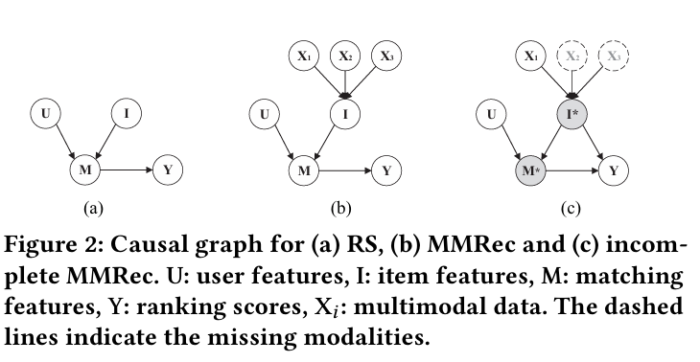
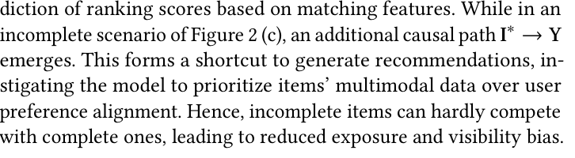
ATAI
Advanced Technique of Artificial Intelligence
ATAI
ChongqingUniversity _{AdvancedTechniqueof}
of Technology Artificial Intelligence
Chongqing University of
Technology
Chongqing University ^{ATAI}
_{of Technology} Advanced Techniqueof
Artificial Intelligence
Chongqing University of Technology
Chongqing University of Technology
Method

Slide 4
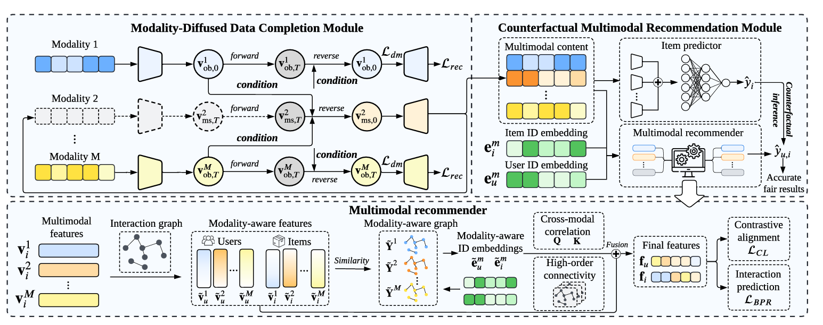
ATAI
Advanced Technique of Artificial Intelligence
ATAI
ChongqingUniversity _{AdvancedTechniqueof}
of Technology Artificial Intelligence
Chongqing University of
Technology
Chongqing University ^{ATAI}
_{of Technology} Advanced Techniqueof
Artificial Intelligence
Chongqing University of Technology
Chongqing University of Technology
Method

Slide 5
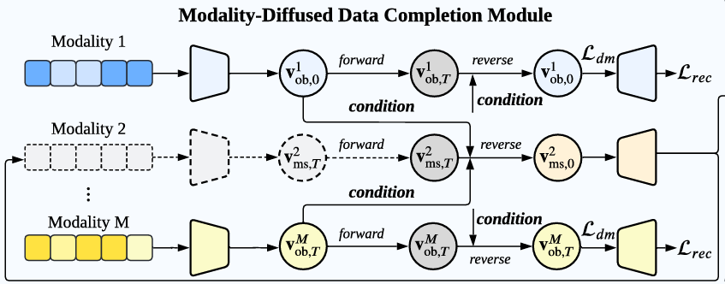
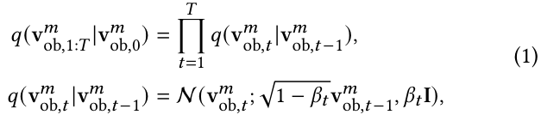

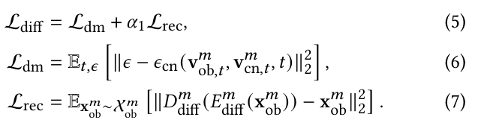

ATAI
Advanced Technique of Artificial Intelligence
ATAI
ChongqingUniversity _{AdvancedTechniqueof}
of Technology Artificial Intelligence
Chongqing University of
Technology
Chongqing University ^{ATAI}
_{of Technology} Advanced Techniqueof
Artificial Intelligence
Chongqing University of Technology
Chongqing University of Technology
Method
Notes:
用子注意力进行融合q为当前模态，k与v为其他模态信息

Slide 6




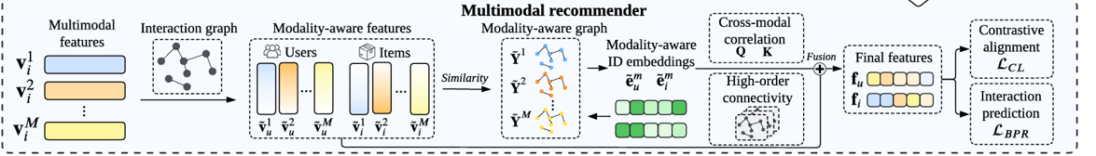
ATAI
Advanced Technique of Artificial Intelligence
ATAI
ChongqingUniversity _{AdvancedTechniqueof}
of Technology Artificial Intelligence
Chongqing University of
Technology
Chongqing University ^{ATAI}
_{of Technology} Advanced Techniqueof
Artificial Intelligence
Chongqing University of Technology
Chongqing University of Technology
Method

Slide 7
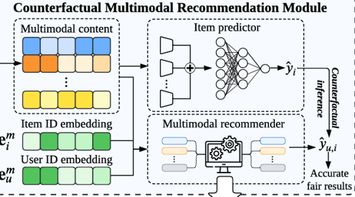

ATAI
Advanced Technique of Artificial Intelligence
ATAI
ChongqingUniversity _{AdvancedTechniqueof}
of Technology Artificial Intelligence
Chongqing University of
Technology
Chongqing University ^{ATAI}
_{of Technology} Advanced Techniqueof
Artificial Intelligence
Chongqing University of Technology
Chongqing University of Technology
Method

Slide 8

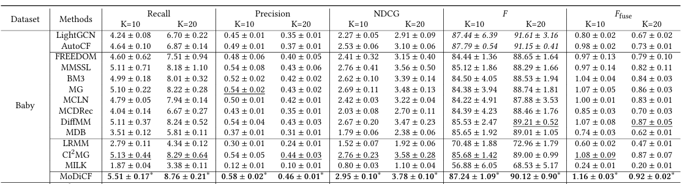
ATAI
Advanced Technique of Artificial Intelligence
ATAI
ChongqingUniversity _{AdvancedTechniqueof}
of Technology Artificial Intelligence
Chongqing University of
Technology
Chongqing University ^{ATAI}
_{of Technology} Advanced Techniqueof
Artificial Intelligence
Chongqing University of Technology
Chongqing University of Technology

Slide 9
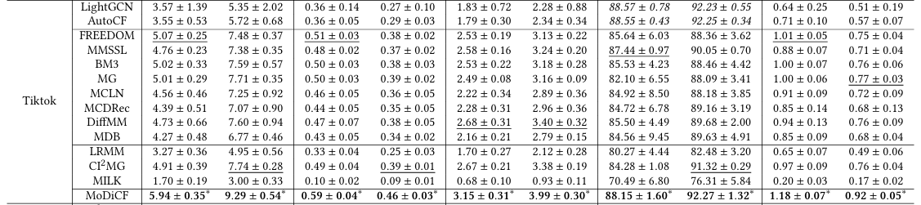
ATAI
Advanced Technique of Artificial Intelligence
ATAI
ChongqingUniversity _{AdvancedTechniqueof}
of Technology Artificial Intelligence
Chongqing University of
Technology
Chongqing University ^{ATAI}
_{of Technology} Advanced Techniqueof
Artificial Intelligence
Chongqing University of Technology
Chongqing University of Technology

Slide 10
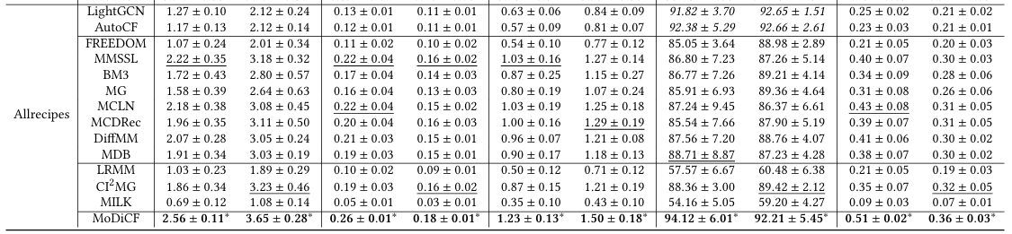
ATAI
Advanced Technique of Artificial Intelligence
ATAI
ChongqingUniversity _{AdvancedTechniqueof}
of Technology Artificial Intelligence
Chongqing University of
Technology
Chongqing University ^{ATAI}
_{of Technology} Advanced Techniqueof
Artificial Intelligence
Chongqing University of Technology
Chongqing University of Technology

Slide 11
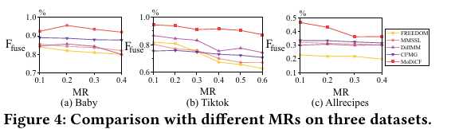
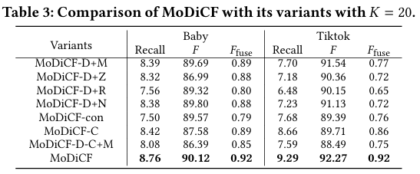
ATAI
Advanced Technique of Artificial Intelligence
ATAI
ChongqingUniversity _{AdvancedTechniqueof}
of Technology Artificial Intelligence
Chongqing University of
Technology
Chongqing University ^{ATAI}
_{of Technology} Advanced Techniqueof
Artificial Intelligence
Chongqing University of Technology
Chongqing University of Technology

Slide 12
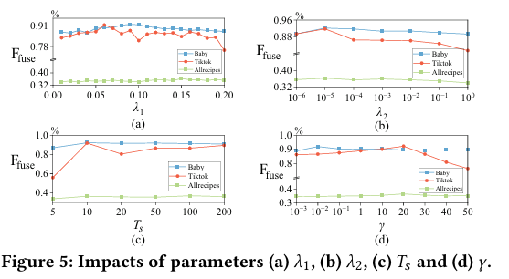
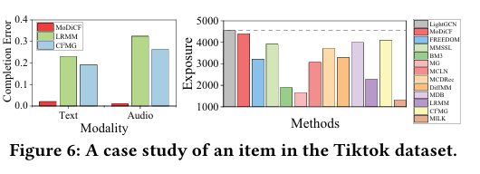
ATAI
Advanced Technique of Artificial Intelligence
ATAI
ChongqingUniversity _{AdvancedTechniqueof}
of Technology Artificial Intelligence
Chongqing University of
Technology
Chongqing University ^{ATAI}
_{of Technology} Advanced Techniqueof
Artificial Intelligence
Chongqing University of Technology
Chongqing University of Technology

Slide 13


ATAI
Advanced Technique of Artificial Intelligence
ATAI
ChongqingUniversity _{AdvancedTechniqueof}
of Technology Artificial Intelligence
Chongqing University of
Technology
Chongqing University ^{ATAI}
_{of Technology} Advanced Techniqueof
Artificial Intelligence
Chongqing University of Technology
Chongqing University of Technology
Thanks!

